Slide 1
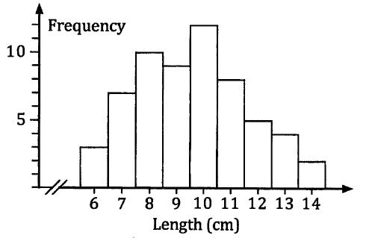
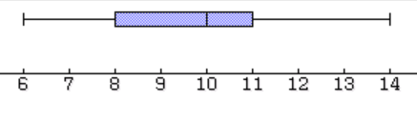
Boxplot or histogram?
The lengths of the tail feathers of sixty female birds of a particular species were measured and the lengths, recorded to the nearest centimetre were as follows:
Below shows the data as a histogram and as a box and whisker plot.
Lengths (cm) | 6 | 7 | 8 | 9 | 10 | 11 | 12 | 13 | 14
Frequency | 3 | 7 | 10 | 9 | 12 | 8 | 5 | 4 | 2
Both of these types of graphs are useful in their own way and each all allows us to see how the data is distributed.
Box plots can be drawn quickly and the 5 number summary can be obtained easily. You can draw several boxplots close to each other which makes It easy to compare distributions.
Histograms show the overall ‘shape’ and symmetry, grouping, gaps, modes can be noticed. You can estimate the mean and standard deviation.

Slide 2
Boxplot or histogram?
Boxplots and histograms are both useful types of data display, each allowing us to build a picture up of how a set of scores are distributed.
Sometimes both forms of display may be given for the same set of data.
Each form provides information about three key parts of a data set.
Its location (where is it?)
Its dispersion (how spread out is it?)
Its shape (what does it look like?)
We have already looked at describing location, dispersion and shape in Chapter 2.
We can now include a description of the standard deviation when considering dispersion (how spread out it is) and we will use histograms and boxplots to describe skewness when considering shape.

Slide 3
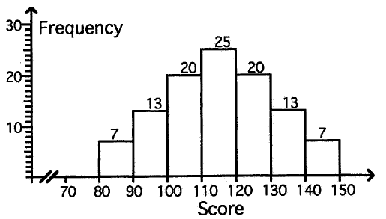
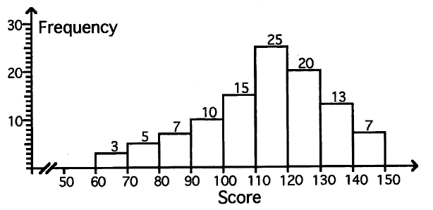
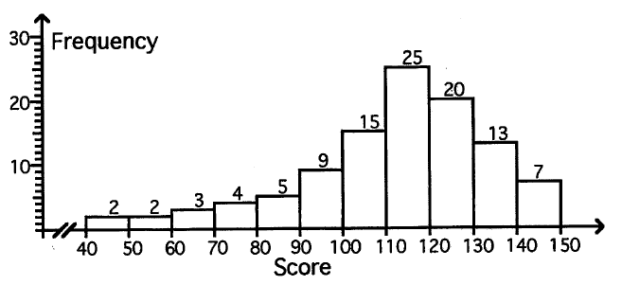
Skewness
In this histogram, we can estimate the mean and standard deviation (using the centre of each class interval) to be:
Mean = 115 and standard deviation =16.04 (to 2dp)
The median would also be in the group 110 – 120.
If the scores to the left of the central column were more spread out, the median would be unaffected but the mean will be lower (left of the median) and the standard deviation will increase (more spread out).
Mean = 112.71 and standard deviation = 19.58 (to 2dp)
If the scores to the left were further spread out, the median would still be unaffected but the mean will be lower again (left of the median) and the standard deviation will increase (more spread out).
Mean = 111.38 and standard deviation = 22.39 (to 2dp)
The first histogram was symmetrical, but the 2nd and 3rd are skewed to the left, also known as negatively skewed.

Slide 4
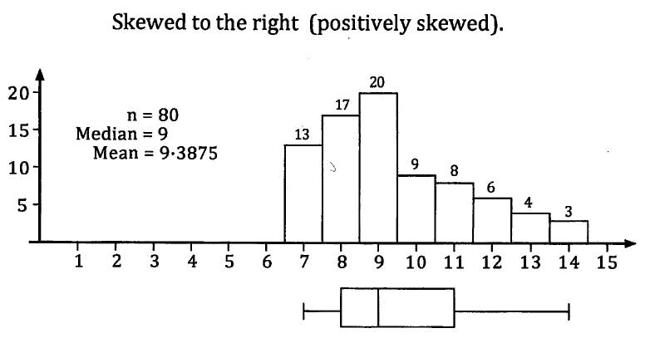
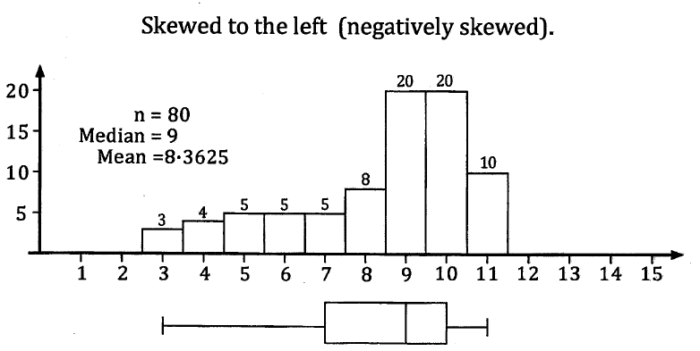
Skewness
If the distribution is skewed to the right (positively skewed), the ‘tail’ to the right will be longer.
We would expect to see a mean higher than the median as the higher scores drags the mean right.
Mean > median
The boxplot will be longer to the right of the median.
If the distribution is skewed to the left (negatively skewed), the ‘tail’ to the left will be longer.
We would expect to see a mean lower than the median as the lower scores drags the mean left.
Mean < median
The boxplot will be longer to the left of the median.

Slide 5
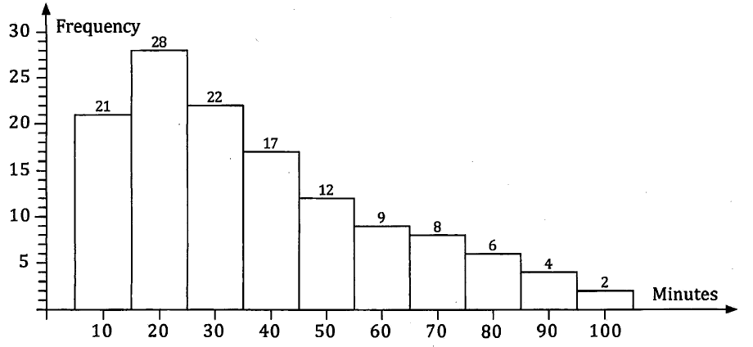
Example 2
129 employees recorded the time of their journeys home.
Relevant information
The employees of a company in Perth CBD were warned that due to accidents and roadworks, their journey home would likely be delayed. They decided to record how long it took each of the employees who drove to work to get home that evening. The histogram shows the distribution of recorded times.
Describe the distribution of scores.
The estimated mean time was 37.6 minutes. The median time was between 25 to 35 minutes
Comment about location (mean, median)
The times were spread from about 5 to 105 minutes; a range of approximately 100 minutes. An estimate for the standard deviation is 23.4 minutes.
Comment about spread (range, IQ range, standard deviation)
The modal class was 15 to 25 minutes. The long tail to the right shows that the distribution is positively skewed.
Comment on shape (symmetry, modality, skewness)
Although the range was about 100 minutes, over half of the employees took between 5 and 35 minutes to get home.
Anything else you notice

Slide 6
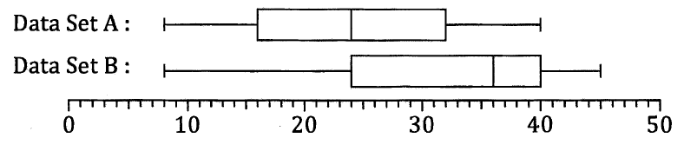
Example 2
Now do exercise 4B
The median for data set B, 36, is much higher than the median for data set A, which is 24.
Both data sets have the same lowest score, 8 , but set B has a larger highest score of 45, compared to 40 for set A.
Relevant information
Compare the distributions shown in the two box plots (data set A and data set B).
Comment about location (mean, median)
Comment about spread (range, IQ range, standard deviation)
Data set B has a range of 37 compared to 32 for set A. Both sets have the same interquartile range, 16.
The box plot for set A is symmetrical with each quartile spanning 8 marks.
Set B has a longer left whisker and the greater part of the box is to the left of the median, suggesting the set B marks are negatively skewed.
Comment on shape (symmetry, modality, skewness)
The median score in set A is the same as the lower quartile score in set B.
The top 25% of marks in set B exceed the maximum mark from set A.
Anything else you notice

